Slide 1
Relational Database Management System 116U01C403

Slide 2


Mapping Cardinality

Slide 3
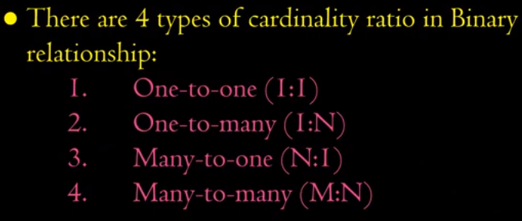


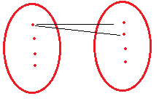

Person-Passport
Student –College
College -Student
Project-Employee

Slide 4
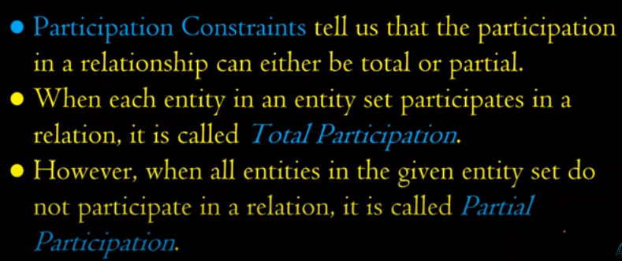
Participation constraints

Slide 5
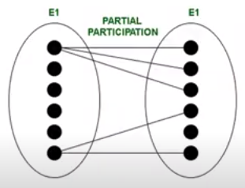
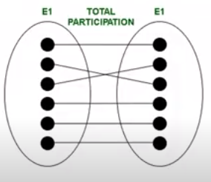

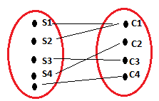
Example

Slide 6


ER-Diagram Naming Convention

